Slide 1
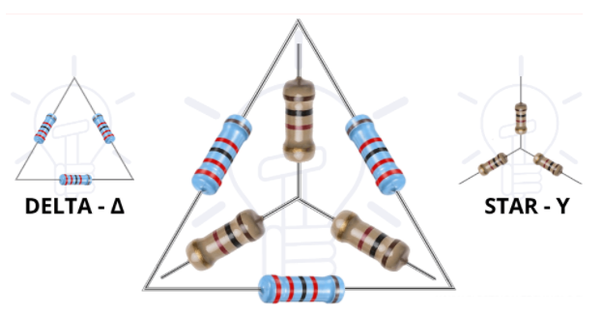
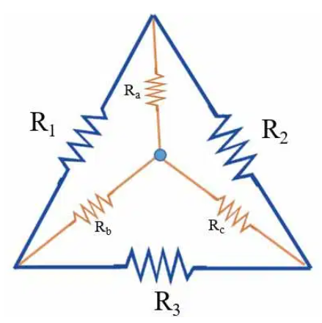
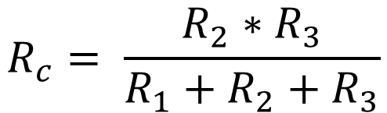
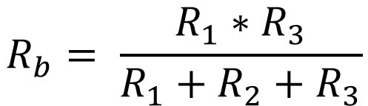
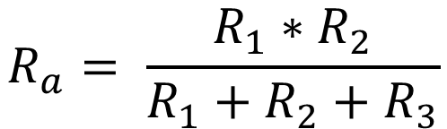
DELTA TO STAR CONVERSION
$$R_{a}= \frac{R_{1}∗R_{2}}{R_{1}+R_{2}+R_{3}}$$
$$R_{c}= \frac{R_{2}∗R_{3}}{R_{1}+R_{2}+R_{3}}$$
$$R_{b}= \frac{R_{1}∗R_{3}}{R_{1}+R_{2}+R_{3}}$$

Slide 2
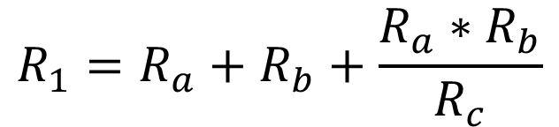
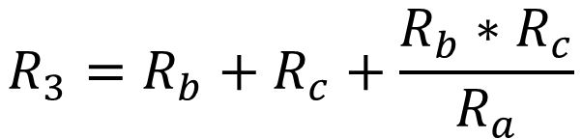
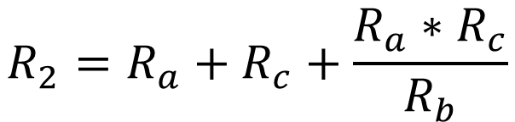
STAR TO DELTA CONVERSION
$$R_{1}=R_{a}+R_{b}+\frac{R_{a}∗R_{b}}{R_{c}}$$
$$R_{3}=R_{b}+R_{c}+\frac{R_{b}∗R_{c}}{R_{a}}$$
$$R_{2}=R_{a}+R_{c}+\frac{R_{a}∗R_{c}}{R_{b}}$$

Slide 3
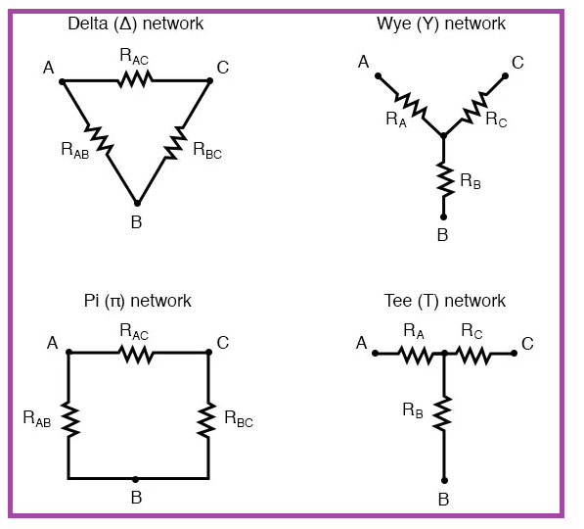
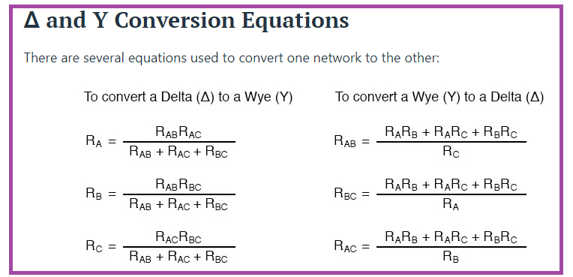

Slide 4
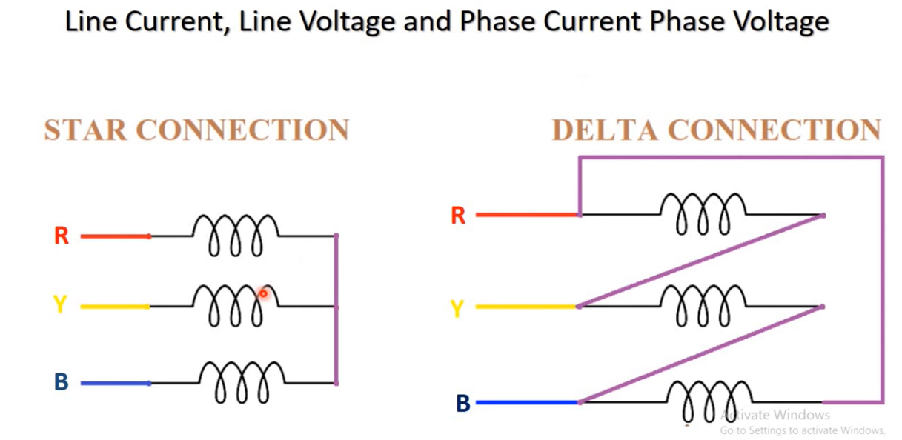

Slide 5
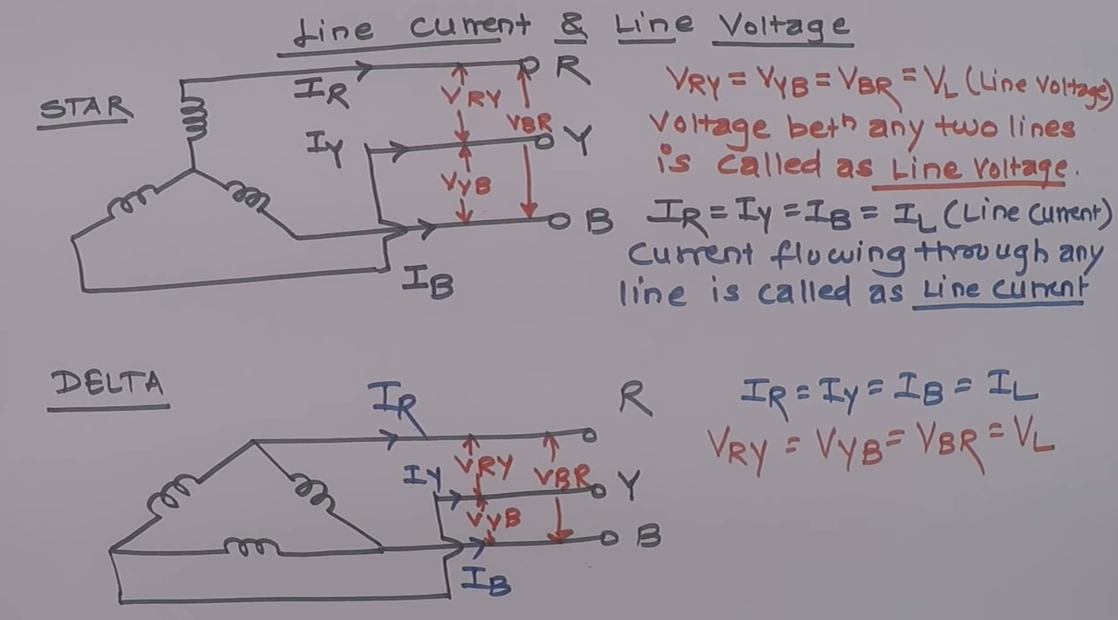
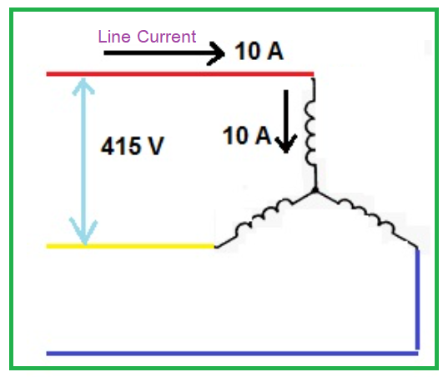
LINE CURRENT AND LINE VOLTAGE
Current flowing through any single line is called Line Current.
Voltage between any two lines is called as Line Voltage.

Slide 6
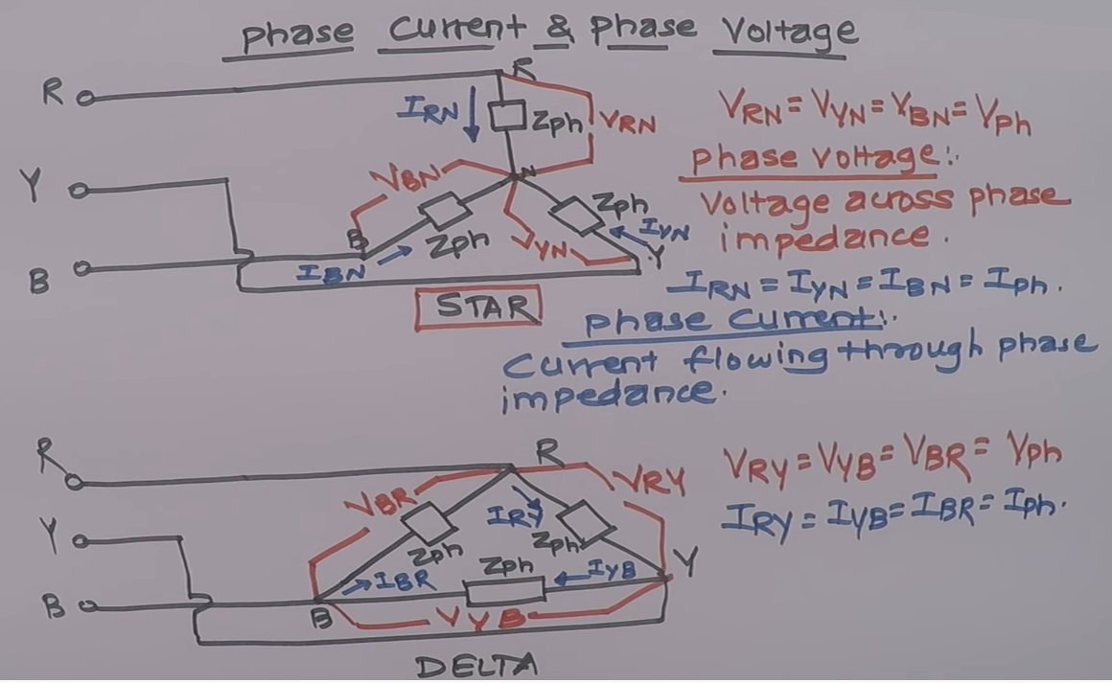
PHASE CURRENT AND PHASE VOLTAGE
Current flowing through any impedance or phase impedance is called Phase Current.
Voltage across impedance or phase impedance is called as Phase Voltage.

